Slide 1
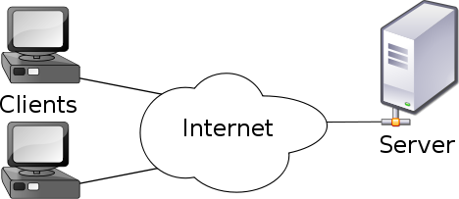
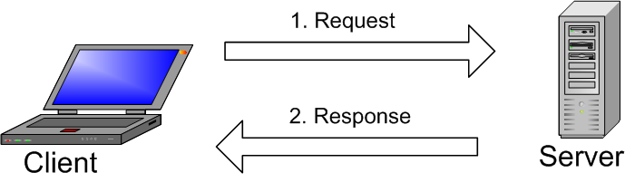
Network Programming
Make a compression service using zlib method.
Maked by Andromeda team:
Dao Duy Nhan – 2011 1939
Hoang Nhu Tam – 2013 3411

Slide 2
System’s component
Server
Wait client connect to, and read requires from client and service.
Client
Read require from user on terminal and send it to server.
Zpipe compression program
Compress file ( encrypt and decrypt) from terminal command.

Slide 3
How do server work?
Load config file to get port which waiting client
Listen, waiting for client
Fork current proceess
Encrypt or Decrypt?
Get file from client using socket
Child process
Return file to client
Call zpipe
to enctypr/decrypt file
Parrent process
End process

Slide 4
How do client work?
Load config file to get port and server address
Connect to server
Send require message:
Encrypt or Decrypt
Upload file to server
Receive File from server
End proccess

Slide 5
How do zpipe work?
Load parameter from terminal
Encrypt of decrypt file
End proccess

Slide 6
Thank you for watching

